Slide 1
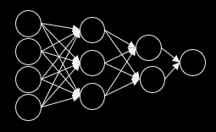
Classifying Melanoma Types from Skin Lesion Images
Neural Networks & Deep Learning Project
Advised By : Dr. Farid Alizadeh
Submitted by:
Nivetha Vedanarayanan
Radhika Rajeevan
Weijun Zhu
Xinran Li
https://github.com/RadhikaR88/Melanoma-Detection
Neural Networks & Deep Learning Project
Advised By : Dr. Farid Alizadeh

Slide 2
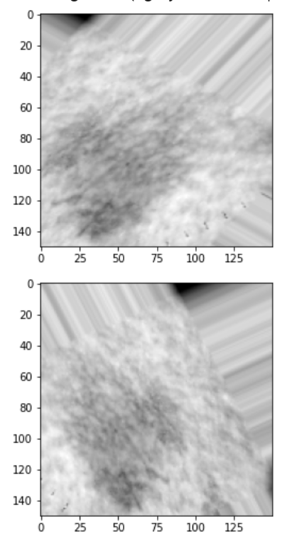
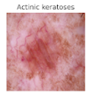
Objective
In this project, we aim to explore the application of Neural Networks in Image Classification for medical diagnosis.
We are using dermoscopic images of pigmented skin lesions and identifying the melanoma type that it belongs to.
Below is a preview of actual image (colored) and images generated by Data Augmentation (b/w)

Slide 3
Motivation
Melanoma are cancerous in nature; however the degree of malignancy differs based on each type.
In 2015 there were a total of 350,000 cases of skin cancer with 60,000 deaths (17%)
If diagnosed early, melanoma survival exceeds 95%
Ref- https://challenge2018.isic-archive.com/

Slide 4
Introduction
Data source
Exploratory Data Analysis
Pre-processing
Approaches
Building CNN
Feature Extraction
Pretrained Model Architecture
Reusing Pretrained Weights
Comparing Models

Slide 5
Data Source & Extraction
The Skin Lesion Images were made available on Kaggle as part of a Melanoma Detection Challenge by the International Skin Imaging Collaboration (ISIC).
There are 10,015 dermoscopic colored images classified into 7 different melanoma types.
Data is extracted from Kaggle into Google drive using Kaggle API.

Slide 6
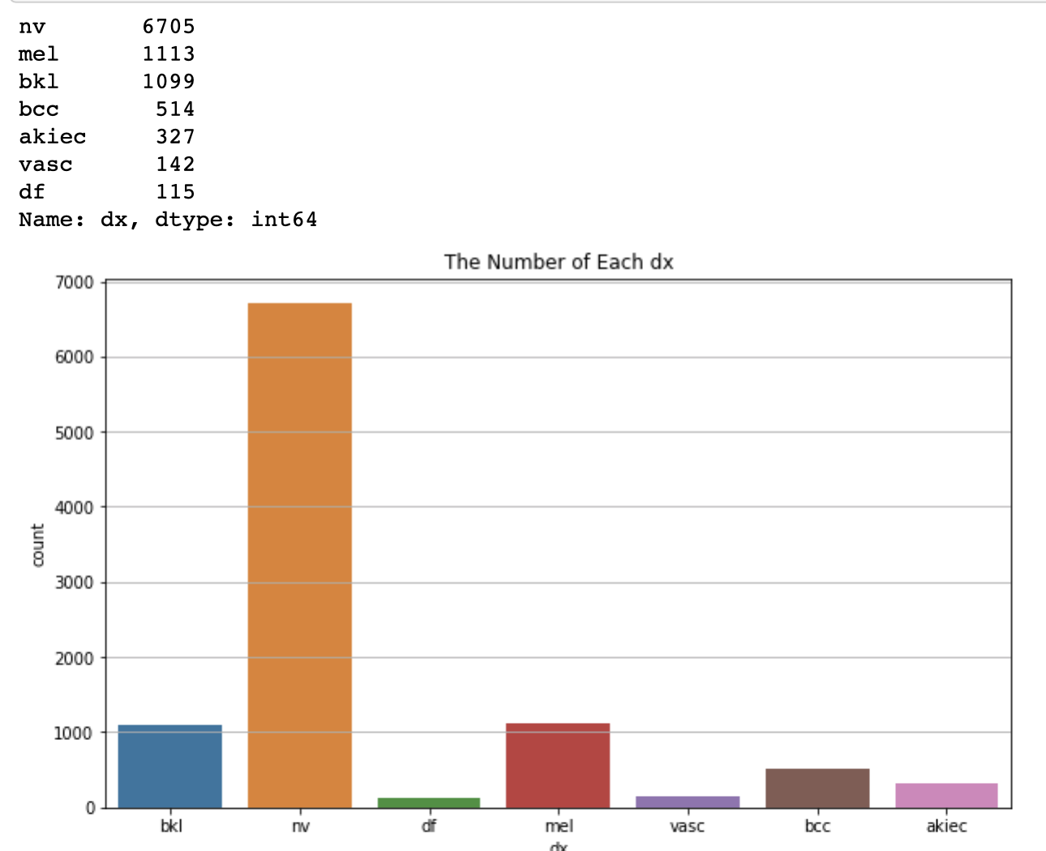
EDA Findings Melanoma Types ‘dx’
dx | Description
nv | Melanocytic nevi
mel | Melanoma
bkl | Benign keratosis-like lesions
bcc | Basal cell carcinoma
akiec | Actinic keratoses
vasc | Vascular lesions
df | Dermatofibroma
By visualizing data, we can tell that the “nv” type is the most common melanoma type. The quantity of “nv” exceed over ½ of the overall collected images.
The other melanoma types are: “bkl”, “df”, “mel”, “vasc”, “bcc”, “akiec”

Slide 7
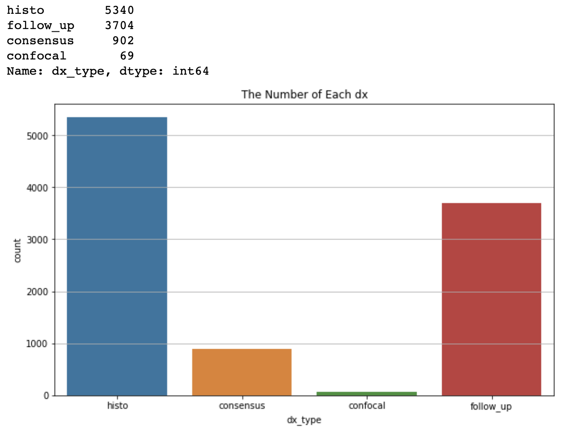
EDA Findings Confirmation ‘dx type’
We notice from the visualization that over 50% of lesions are confirmed through “histo”.
While “follow_up” play another major role in confirming cases, we could also confirm by “consensus” and “confocal”.

Slide 8
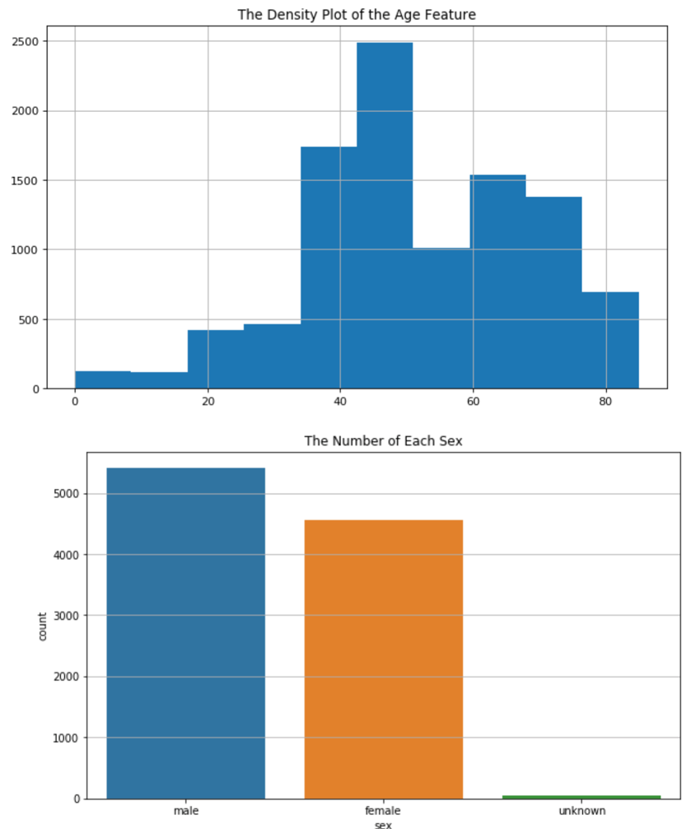
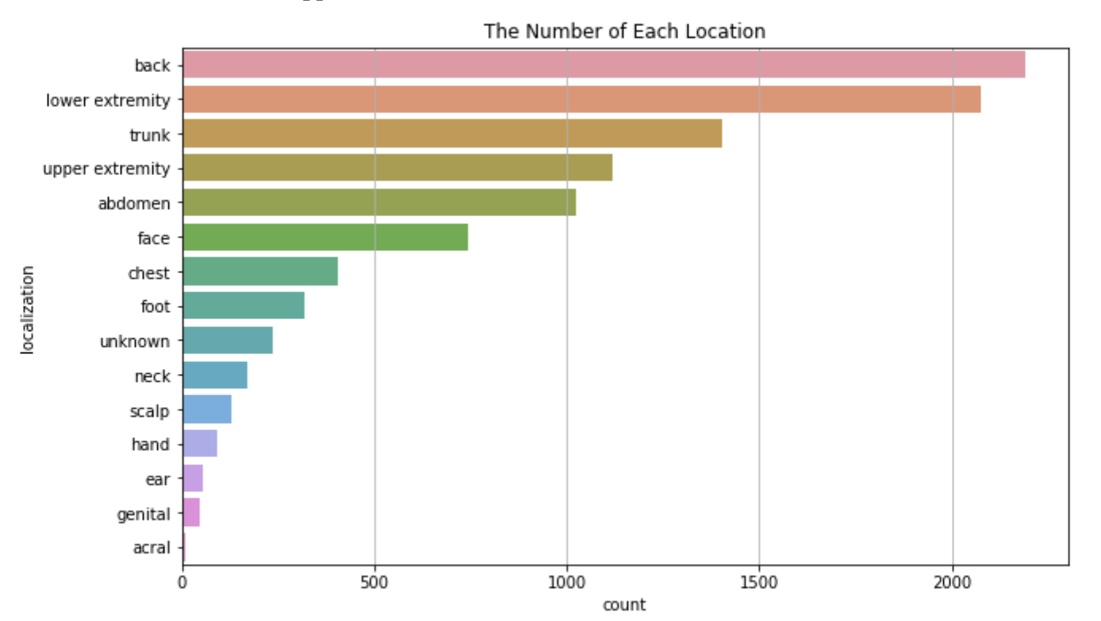
Additional features

Slide 9
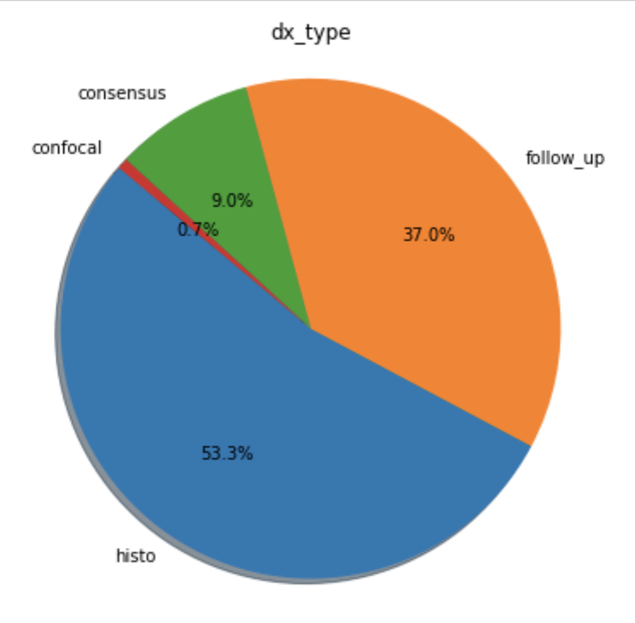
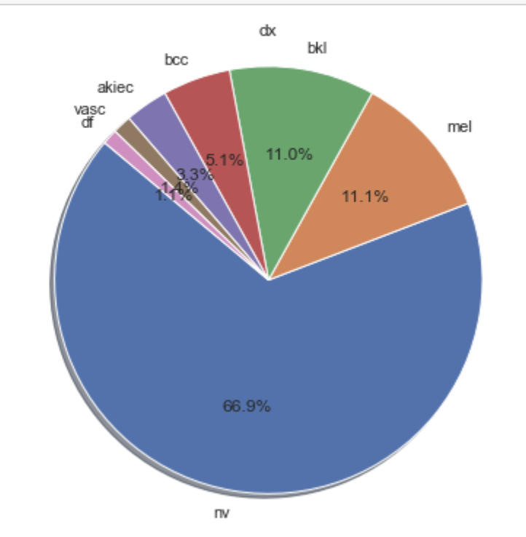
Additional features

Slide 10
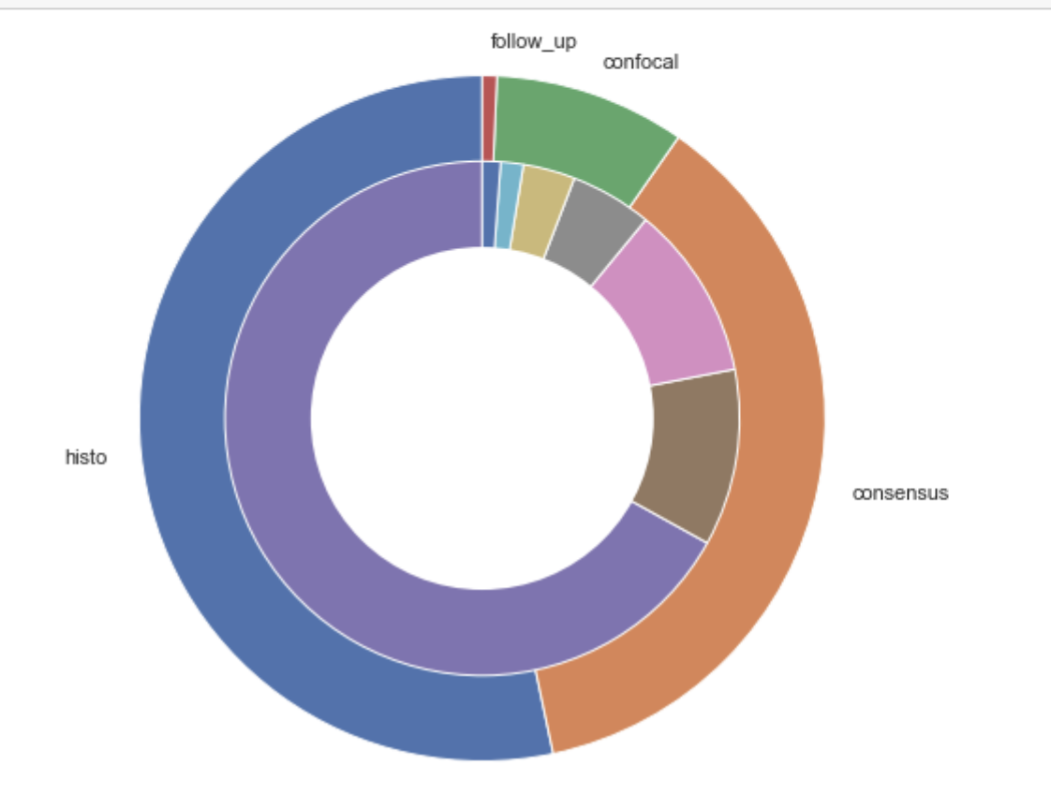
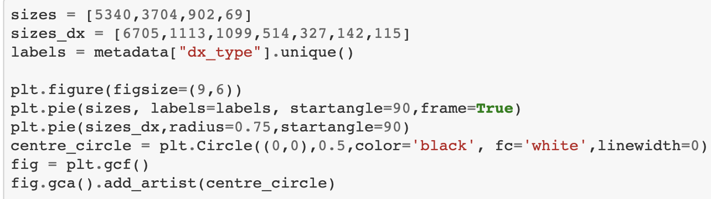
EDA Findings Relating ‘dx type’ & ‘dx’

Slide 11
Preprocessing
Scaling Data
Images were converted to numeric arrays and scaled between 0 and 1 and saved as npy files.
We have tried models with 3 different dimensions:
128 x 128 x 3
150 x 150 x 3
224 x 224 x 3
Class Imbalance
Since class proportions are highly skewed, we have used Data Augmentation to generate rotated images for classes with less training data for a class-wise balance.

Slide 12
MobileNet
MobileNet with 128 x 128 x 3 arrays
Train-Val-Test Split
Model Architecture
Saving the Models in .h5 for reuse
Learning Rate
Accuracy & Loss
Performance on Test Data
Confusion Matrix
Precision & Recall

Slide 13
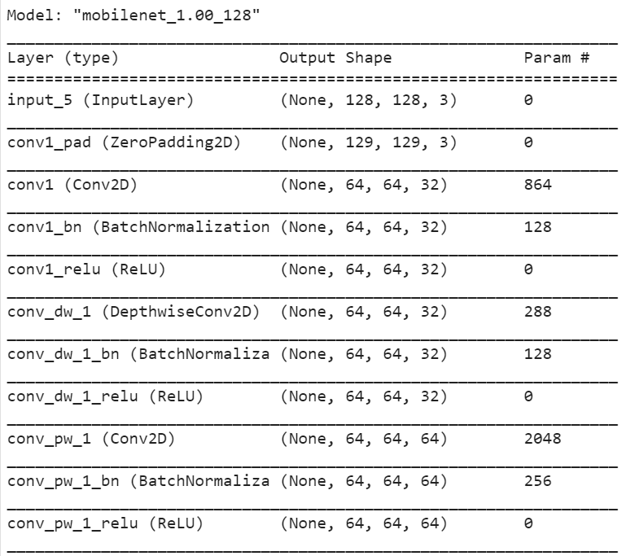
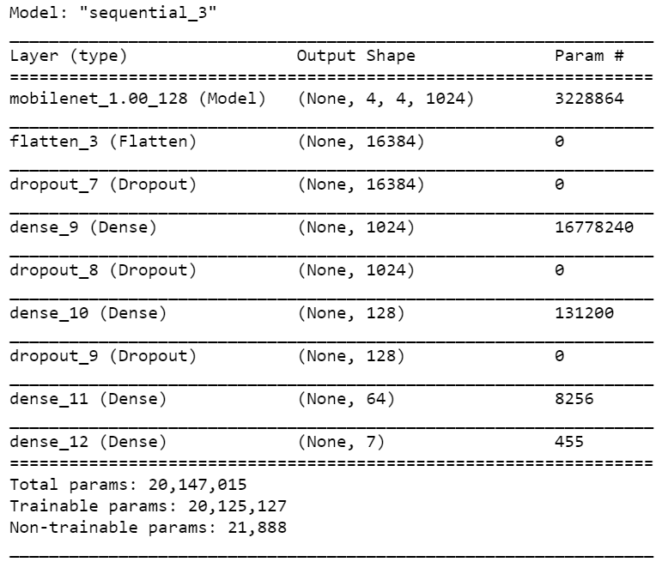
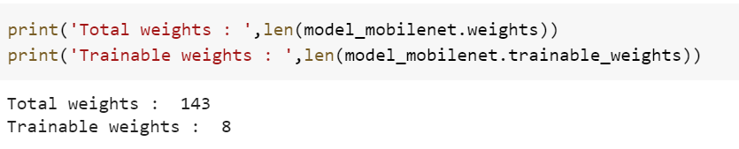
MobileNet Architecture
Freeze the pretrained MobileNet weights
Base MobileNet model
Custom Dense Layer added at the end

Slide 14
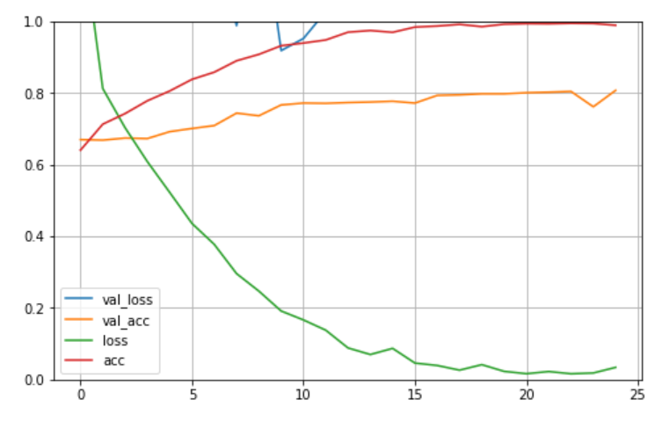
MobileNet Performance
Learning Rate of 0.0001
Optimizer - RMSProp
The validation loss is > 1 and does not drop
Validation accuracy does not improve beyond 80%

Slide 15
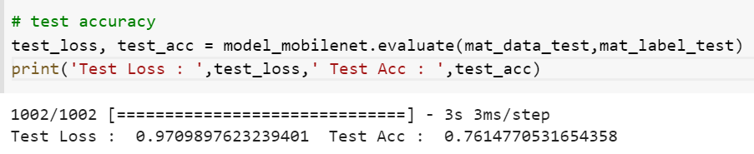
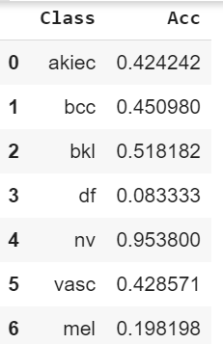
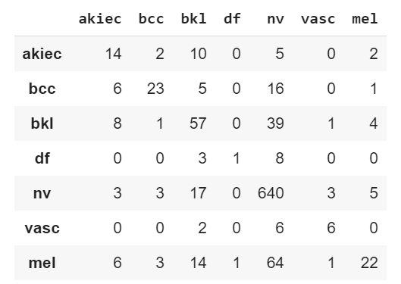
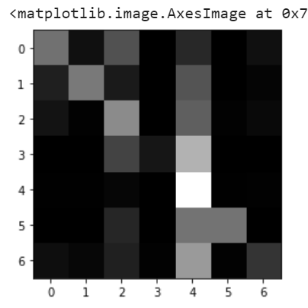
MobileNet Test Data
Identification of ‘df’ is extremely low : 8%
Except ‘nv’ rest of classes have an accuracy of <= 50%

Slide 16
MobileNet with Data Aug
MobileNet with Data Augmentation
Images are Generated on Imbalanced class images
Model Architecture
Saving the Models in .h5 for reuse
Learning Rate
Accuracy & Loss
Performance on Test Data
Confusion Matrix
Precision & Recall

Slide 17
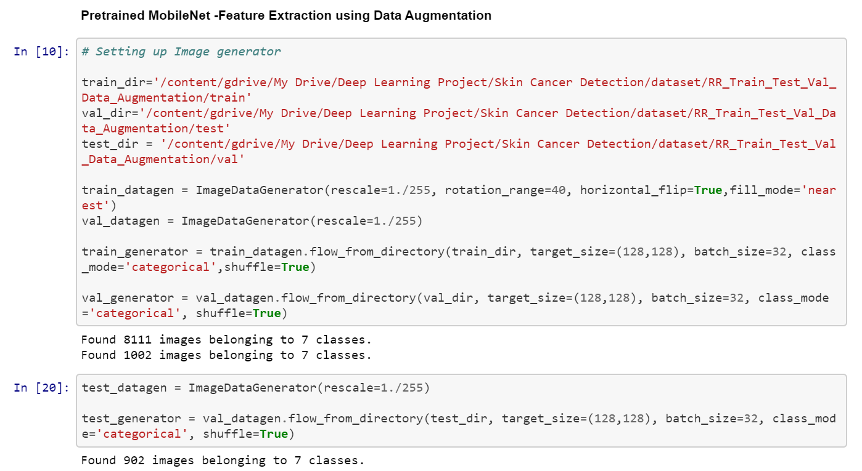
MobileNet with Data Aug
Data Augmentation

Slide 18
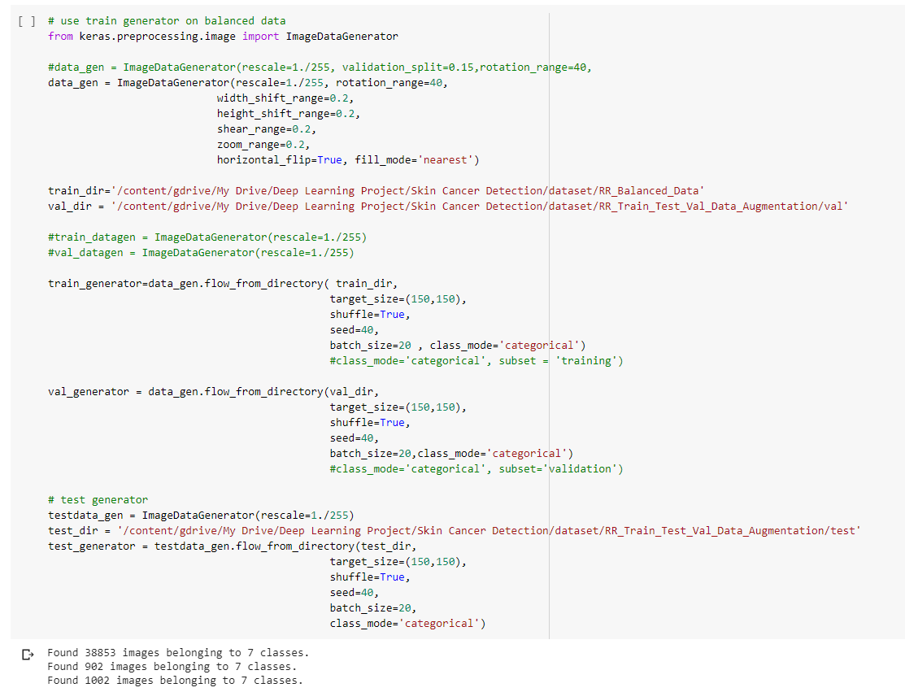
MobileNet with Data Aug
Data Augmentation
Generating rotated images for classes with proportionately lower data

Slide 19
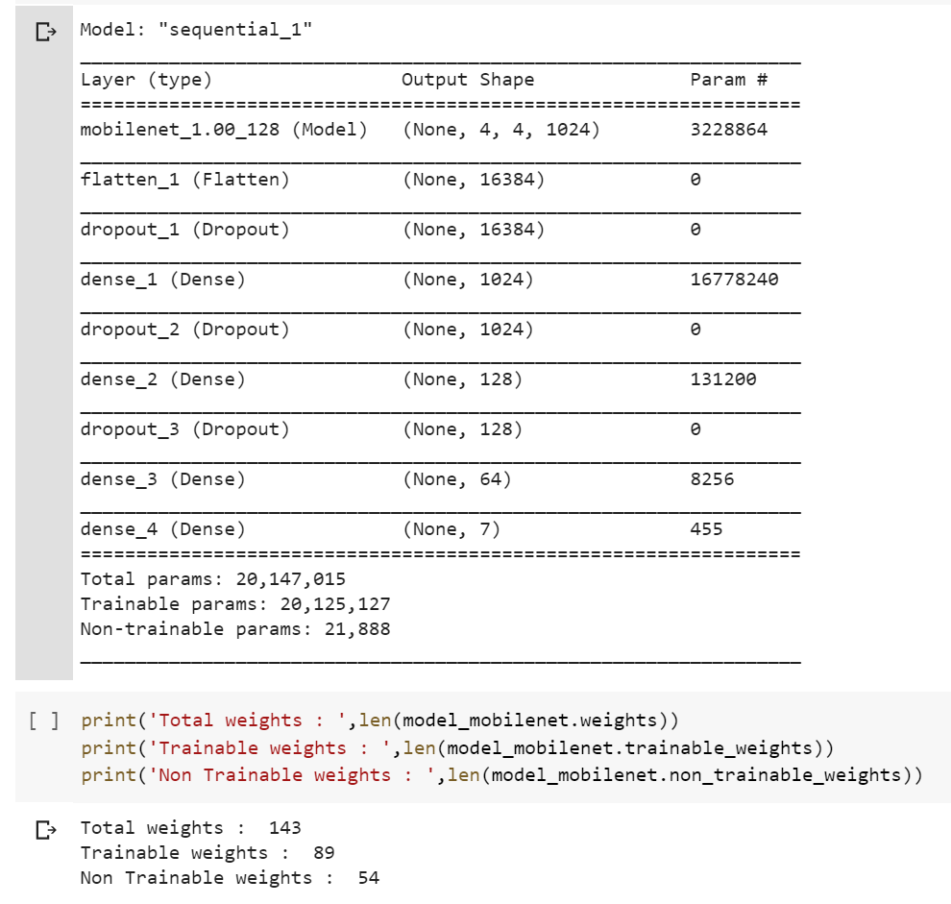
MobileNet-DA Architecture
Freeze partial layers of the pretrained MobileNet base

Slide 20
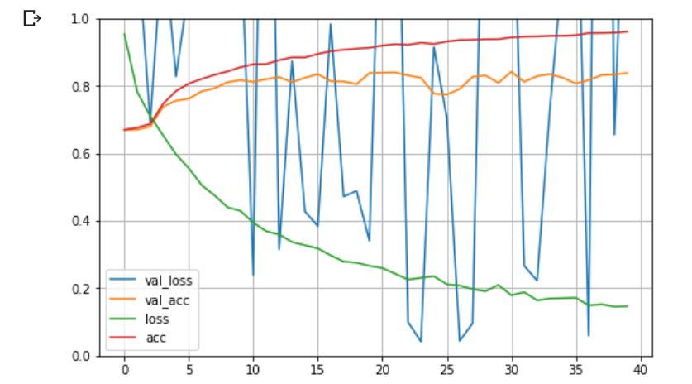
MobileNet-DA Performance
Learning Rate of 0.0001
Optimizer – RMSProp
steps_per_epoch=(train_size/batch_size)
High fluctuation in validation loss
Validation accuracy improves slightly beyond 80%

Slide 21
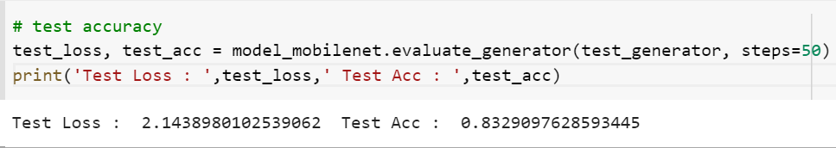
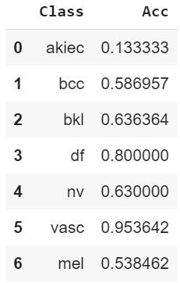
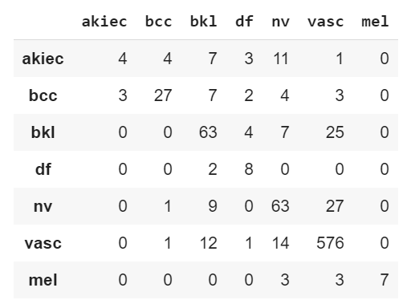
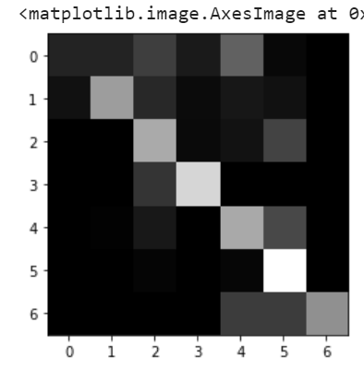
MobileNet-DA Test Data
Identification of ‘df’ is extremely low : 8%
Except ‘nv’ rest of classes have an accuracy of <= 50%

Slide 22
Improvements
Downgrades
Accuracy for ‘akiec’ has dropped from 42% to 13%
‘nv’ has dropped from 95% to 63%
Identification of ‘df’ has improved from 8% to 80%
Fewer misclassifications

Slide 23
MobileNet Comparing Models
Precision & Recall
ROC curve
Compare MobileNet models
Note : The MobileNet models are an improvement over a basic 6 layered CNN model which yields up to 75% accuracy

Slide 24
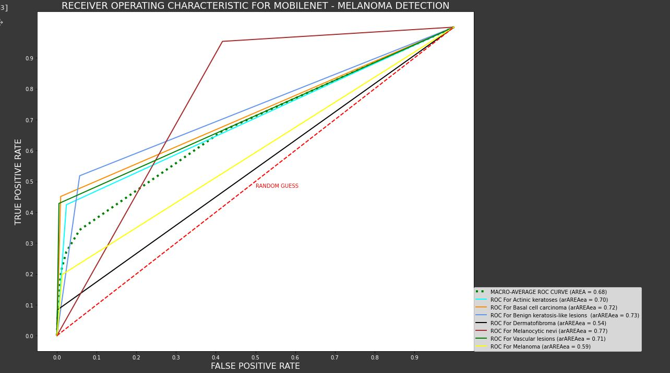

Slide 25
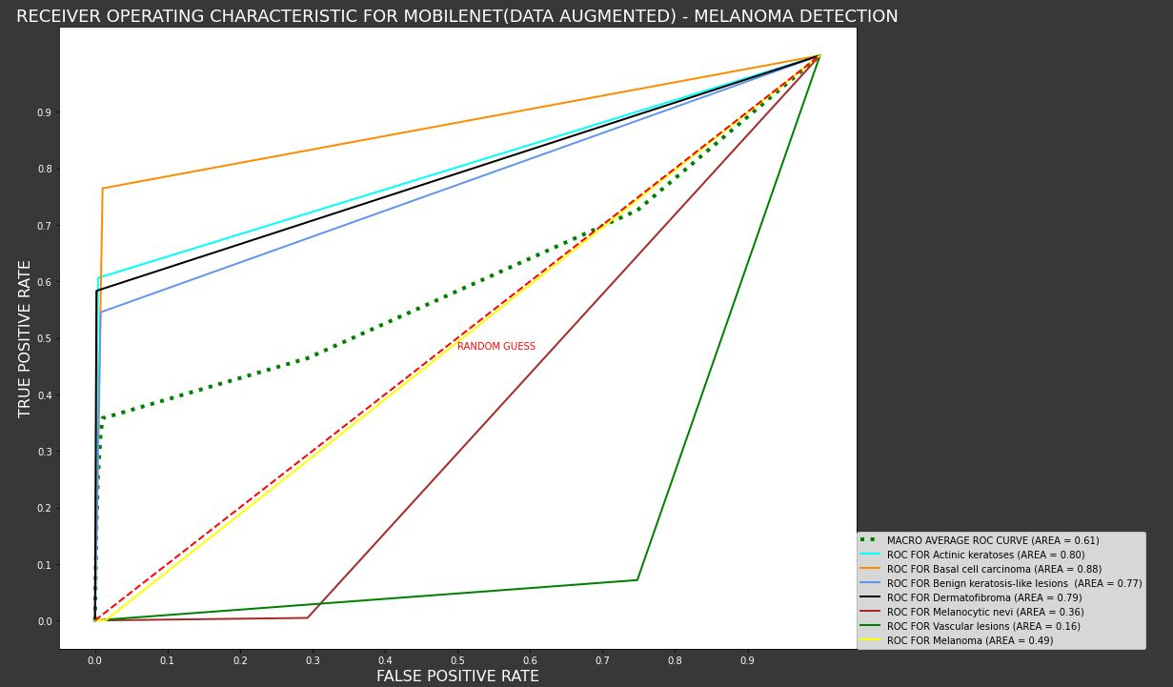

Slide 26
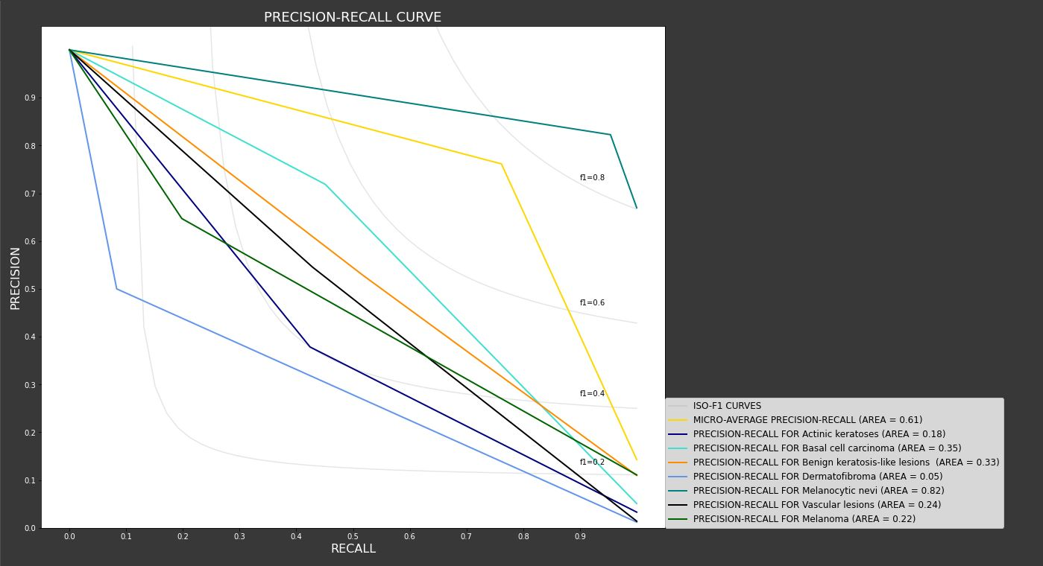

Slide 27
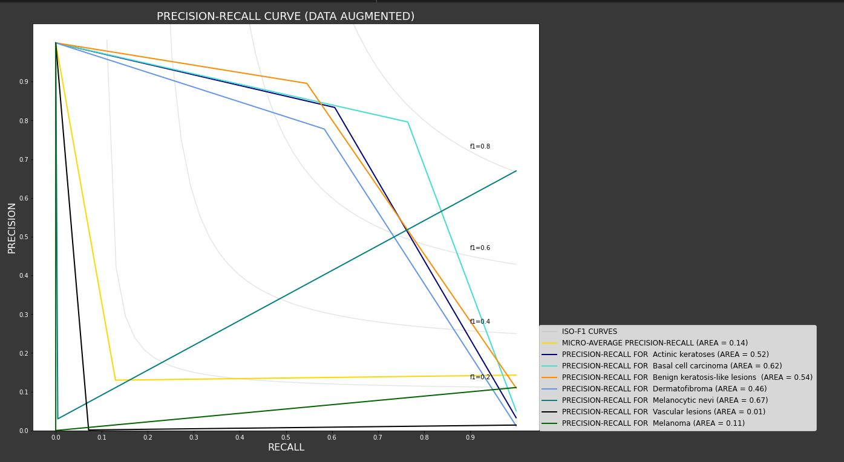

Slide 28

Part IV
ResNet50
Weijun Zhu

Slide 29
Residual Neural Network
Deeper neural networks are more difficult to train, and sometimes researchers find the deeper neural network get the worse results than the shallower one.
ResNet was found by Kaimin in 2015, and it is good to fit the model in the deeper neural network.
They explicitly reformulate the layers as learning residual functions with reference to the layer inputs, instead of learning unreferenced functions.

Slide 30
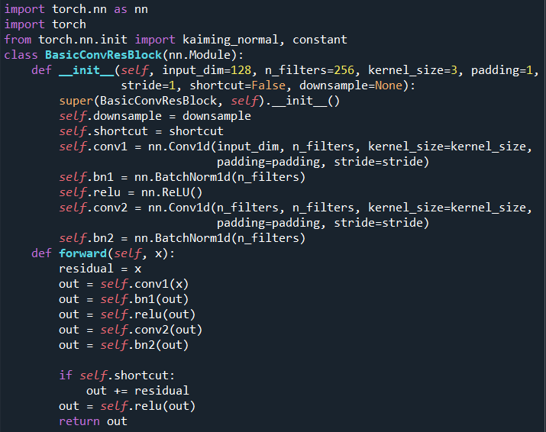
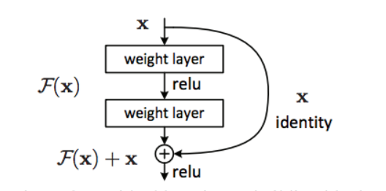
Residual Neural Network

Slide 31
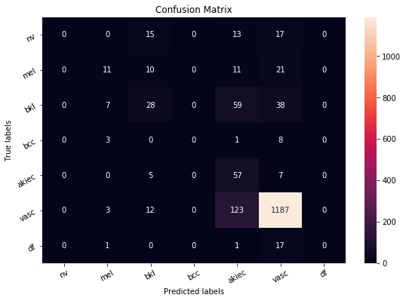
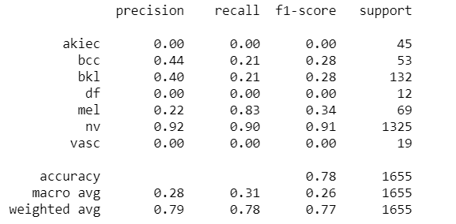
ResNet 50

Slide 32

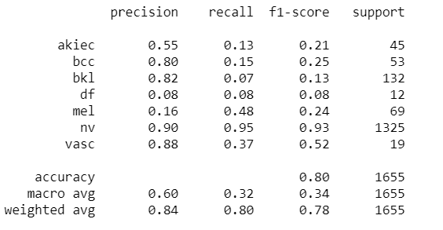
MobileNet

Slide 33
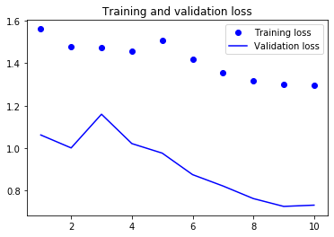
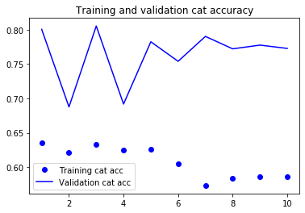
ResNet 50; epoch=10

Slide 34
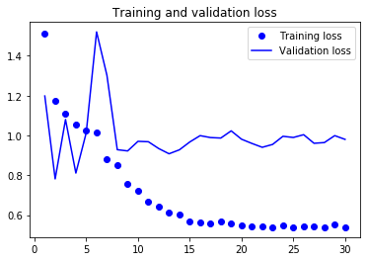
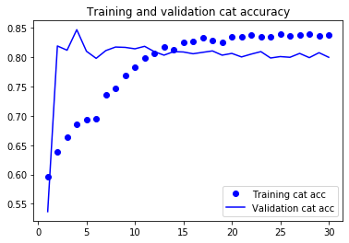
MobileNet; epoch=30

Slide 35
Reference
Deep Residual Learning for Image Recognition, Kaiming He, Xiangyu Zhang, Shaoqing Ren, Jian Sun
Identity Mappings in Deep Residual Networks, Kaiming He, Xiangyu Zhang, Shaoqing Ren, Jian Sun
MobileNets: Efficient Convolutional Neural Networks for Mobile Vision Applications, Andrew G. Joward, Menglong Zhu, Bo Chen, Dmitry Kalenichenko, Weijun Wang, Tobias Weyand, Marco Andreetto, Hartwig Adam
https://www.zhihu.com/search?type=content&q=%E6%AE%8B%E5%B7%AE%E7%A5%9E%E7%BB%8F%E7%BD%91%E7%BB%9C
https://towardsdatascience.com/introduction-to-resnets-c0a830a288a4

Slide 36
Thank you

